Slide 1

The Korfovsky urban settlement
of Khabarovsk municipal district
Khabarovsk region
The analysis of investment
potential of the Korfovsky
settlement of Khabarovsk region

Slide 2


The brief characteristic of settlement
The Korfovsky settlement is the administrative center of Korfovsky urban-type community of Khabarovsk district
 | The population: | 3884 people
 | The area: | 812,3 hectare
 | The distance to the center (Khabarovsk city): | 14 km
s

Slide 3
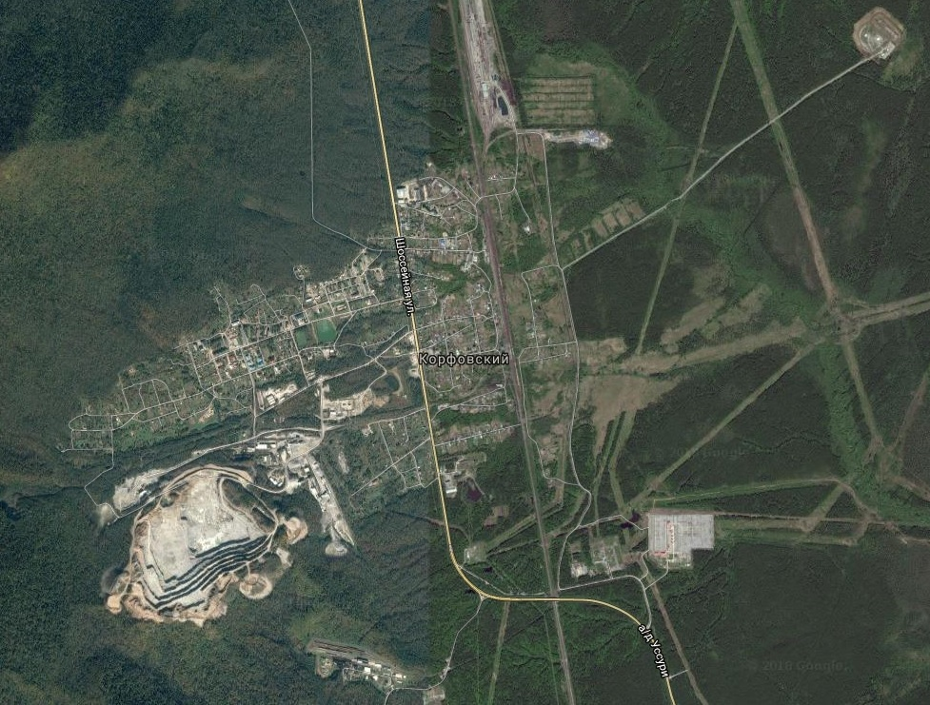
The map image of settlement
The Korfovsky settlement
Far Eastern rail line
Federal highway
Quarry

Slide 4

The logistics potential of settlement
The Korfovsky settlement is located at the intersection of most important logistics routes of the Far East of Russia. The main ways crossing settlement are::
The Far Eastern rail line. Khabarovsk-Vladivostok (the Korfovsky station)
The Federal highway A370 «Ussury» Khabarovsk-Vladivostok
The strategic highway «Detour of Khabarovsk city 13km-42 km» (The way under construction is 14 km near the settlement, full entry into service for this road is scheduled for 2021) (http://khabarovskhighway.pmagency.ru/ )

Slide 5
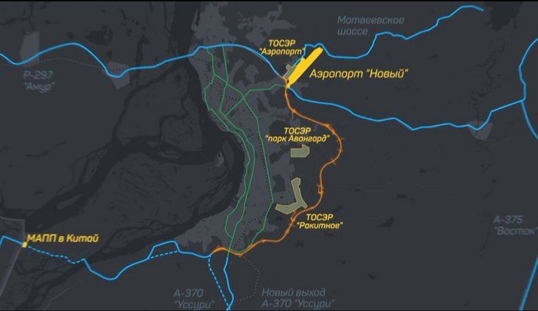
The strategic highway «Detour of Khabarovsk city 13km-42 km»
The Airport «Novyi»
TAD «Avangard Park»
Khabarovsk city
The way under construction will connect the 3 strategic objects: the territories of advanced development (TAD): «Rakitnoe», «Avangard Park»,
the Airport
TAD Rakitnoe
The road in Chine
The Korfovsky
settlement

Slide 6
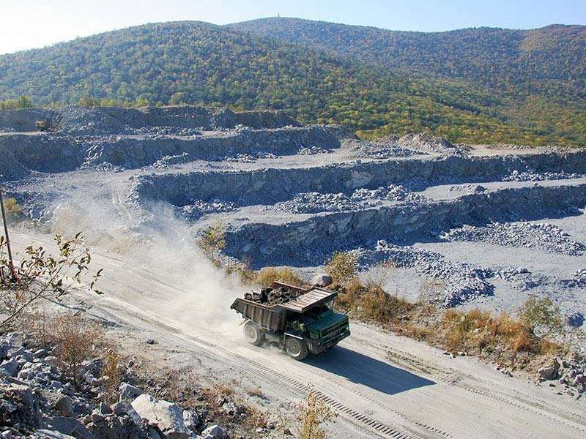
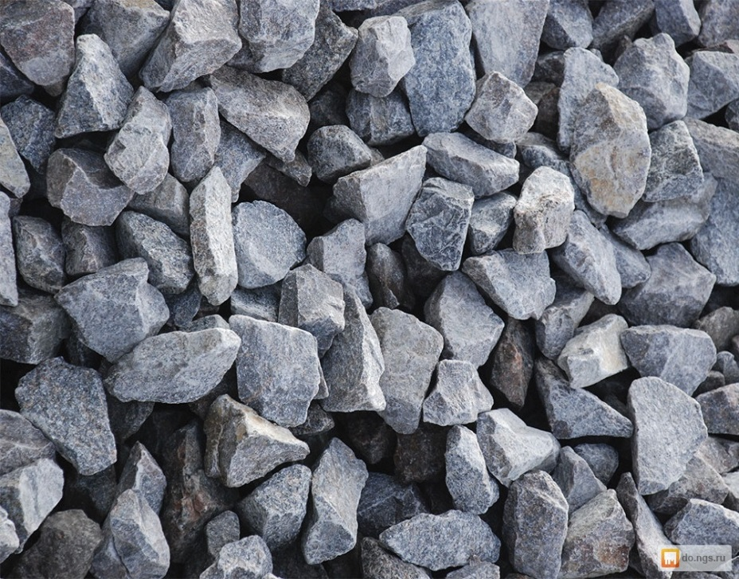
Economic potential of Korfovsky settlement
The big granodiorite deposit (building stone) is located on the settlement territory
The group of companies «Korfovsky kamennyi karier» are quarrying and producing stone products (http://oaokkk.ru/)

Slide 7
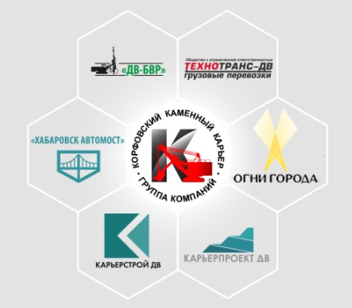
The group of companies «Korfovsky kamennyi karier»
The group is a multi-profile holding consisting of Head enterprise AO «Korfovsky kamennyi karier» and six subsidiary companies
The products manufactured and sold by companies:
-crushed stone of various fractions
-stone
-the sand from the screenings of crushing
- a mixture of construction
- concrete
- concrete solution
- reinforced concrete structure
- sand seeded
The output of main products
(crushed stone of various fractions)
are 1 million and 100 hundred
thousand cubic meters per year

Slide 8
The utility infrastructure
The Korfovsky settlement has the centralized systems of heat supply, water supply, water disposal and electric supply
Heat supply | Autonomous coal boiler houses | 2
Water supply | Water tower and artesian wells | 5
Electric supply | Transformer substation | 9
Water disposal | Treatment facilities of mechanical cleaning and biological treatment | 2

Slide 9
Utility costs as at 01.01.2018
Utility resource | Unit | Norm | Tariff, rubles
Thermal energy | Gcal | 0,0518 Gcal / sq m | 6442,80 rubles / Gcal
Cold water | Cubic meters | 4,9052 cubic meters per month | 57,57 per cubic meters
Water disposal | Cubic meters | 4,9052 cubic meters per month | 49,26 per cubic meters
 | kW | From 150 to 670 kW | 158 805,59 rubles/ MW per month
Electric supply | kW/MW | From 670 kW to 10 MW | 109 178,84 rubles/ MW per month
 | MW | No less than10 MW | 64514,77 rubles/ MW per month

Slide 10
SWOT-analysis of the Korfovsky settlement
Strengths |  | Weaknesses
1. There are vacant land (total area 55 hectares for production facilities and capacities) with a driveway. 2. Advantageous location of the Korfovsky settlement on the intersection of highways (rail line and roadway) that connect the major regional centers of the Far East of Russia. 3. The presence on the territory large raw material base of building stone (quarry) for derivative building materials – bricks, cinder blocks, paving slabs. 4. The territory has compact community infrastructure of enough power for production capacities smooth operations |  | 1. The high cost of capital construction of production facilities and high cost of their technological connection to community infrastructure. 2. High energy intensity and high consumption of materials. 3. The lack of on-site the educational organizations for training of qualified personnel. 4. The lack of on-site the specialized investment zones with the additional government preferences for the investor companies.

Slide 11
SWOT-analysis of the Korfovsky settlement
Opportunities |  | Threats
1. The state support of investment activity in Far East territory, the organization of the advanced development territories (TAD) in the Khabarovsk district. 2. The favorable market conditions that connected with the growth of capital construction in Far East territory (including the territory of The Korfovsky urban-type community). 3. The strengthening of economic relations with China. The access to the Chinese roads (highway G-1011 to Harbin and highway G-11) can promote expansion of the sales market and increase in sales of Korfovsky settlement production. |  | 1. The rising prices of fuel and energy resources and raw materials. 2. The high cost of production in comparison with competitors-residents of the advanced development territories in the Khabarovsk district. 3. The instability and imperfection of the legal framework, the tightening of normative and technical standards that creating bureaucratic barriers in the realization activity of the organization-investors. 4. The fluctuations in demand for the Far Eastern products including Korfovsky settlement products due to high costs of manufacturing.

Slide 12
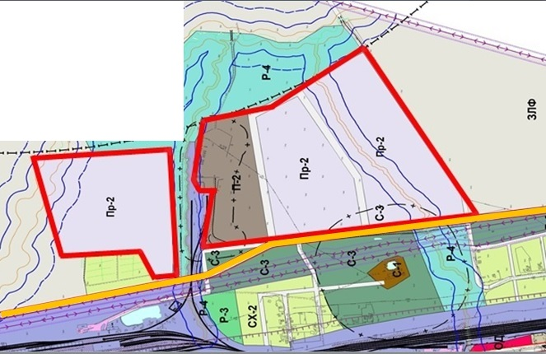

The investment project proposals
The legend keys
 | The land proposed for the development
 | The road travel to the land plots
 | The Far Eastern railway

Slide 13
The investment project proposals
1. The land proposed for the development has total area 55 hectares for production facilities, buildings and industrial enterprises.
2. The area and configuration of land plot for rent is determined based on the project scale and specifics of investor's activity.
3. For investment organizations in Korfovsky urban-type community there is a reduced rate tax for the lease of land plots.
4. There is a road travel to the land plots with a crushed stone-gravel coating. The road is adjacent to federal highway A370 «Ussury» Khabarovsk-Vladivostok and he land plot is adjacent to railway deadlock of Far Eastern railway.

Slide 14

The investment project proposals
5. There is a possibility of technological accession of the planned facilities to the centralized systems of communal service including heat supply, water supply, water disposal and electric supply (nearest connection point - 560 m).
6. The administration of the urban-type community shall guarantee assistance for investors, including preparation technological condition for connection to centralized systems of communal service on the principle of «Single window».
7. The big deposit of building stone (quarry) is located on the settlement territory. It located 4 km from the proposed land plots.

Slide 15
The investment project proposals
8. One of the activities of investors can be building materials production (bricks, cinder blocks, paving slabs, wall plates, side stones, ground plates, plates for facing). In the present time, production of these products is absent.
9. In relation to implementation of large investment projects in Russian Far Eastern territory (capital construction and repair of strategic objects), the sales market of the Korfovsky settlement's production can be: Khabarovsk region, Primorsky Krai, Jewish Autonomous region, Amur region, Sakhalin region, Republic of Sakha Yakutia.

